Slide 1

MAC Layer and attacks

Slide 2
MAC Layer
Ethernet frame and MAC header
MAC address and ARP Protocol
ARP cache poisoning attack
MITM attacks using ARP cache poisoning

Slide 3
Network Protocols Stack
Application protocol
Application
Application
Transport
TCP protocol
Transport
Network
IP protocol
IP
IP protocol
Network
Link
Data Link
Network Access
Data Link
Link

Slide 4
Types of Addresses in Internet
Media Access Control (MAC) addresses in the network access layer
Associated w/ network interface card (NIC)
48 bits or 64 bits
IP addresses for the network layer
32 bits for IPv4, and 128 bits for IPv6
E.g., 128.3.23.3
IP addresses + ports for the transport layer
E.g., 128.3.23.3:80
Domain names for the application/human layer
E.g., www.purdue.edu

Slide 5
Routing and Translation of Addresses
Translation between IP addresses and MAC addresses
Address Resolution Protocol (ARP) for IPv4
Neighbor Discovery Protocol (NDP) for IPv6
Routing with IP addresses
TCP, UDP, IP for routing packets, connections
Border Gateway Protocol for routing table updates
Translation between IP addresses and domain names
Domain Name System (DNS)

Slide 6
Threats in Networking
Confidentiality
Packet sniffing
Integrity
Session hijacking
Availability
Denial of service attacks
Common
Address translation poisoning attacks
Routing attacks

Slide 7
Concrete Security Problems
ARP is not authenticated
APR spoofing (or ARP poisoning)
Network packets pass by untrusted hosts
Packet sniffing
TCP state can be easy to guess
TCP spoofing attack
Open access
Vulnerable to DoS attacks
DNS is not authenticated
DNS poisoning attacks

Slide 8
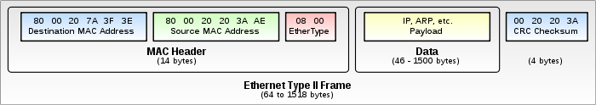
Ethernet Frame and MAC Header

Slide 9
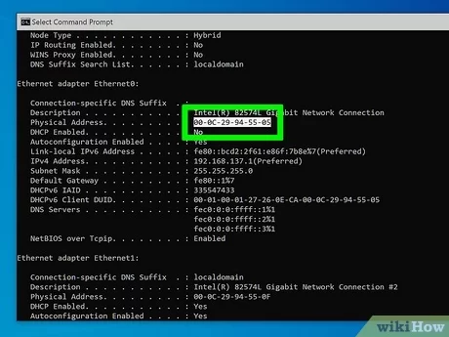
MAC Address

Slide 10
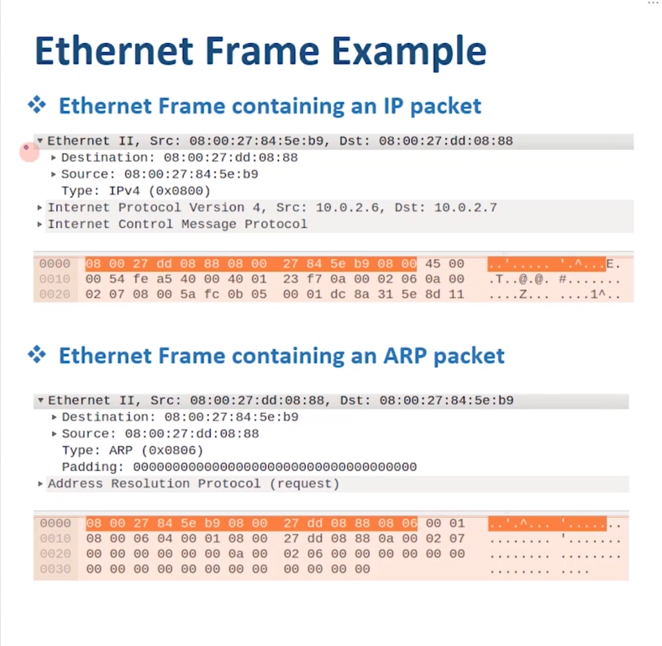
Wireshark Capture – MAC

Slide 11
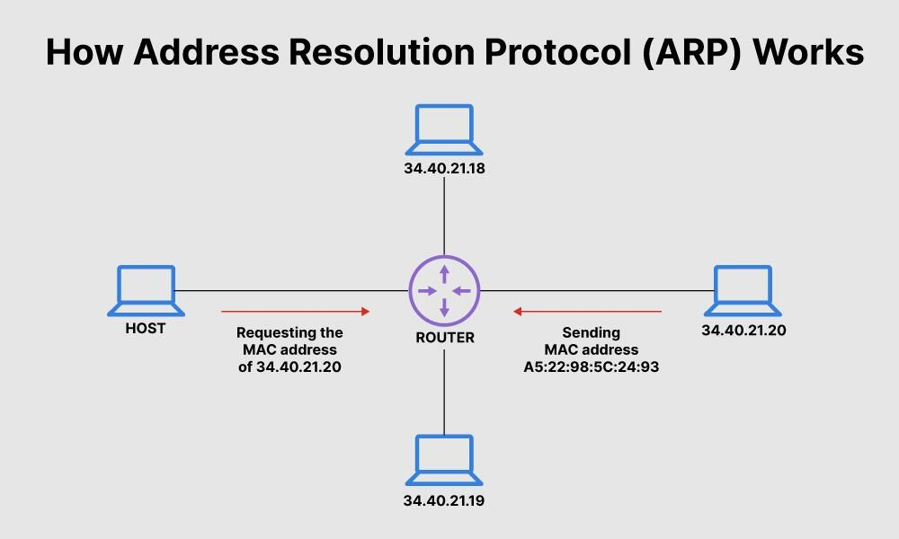
Address Resolution Protocol (ARP)
Primarily used to translate IP addresses to Ethernet MAC addresses
The device drive for Ethernet NIC needs to do this to send a packet
Also used for IP over other LAN technologies, e.g., FDDI, or IEEE 802.11
Each host maintains a table of IP to MAC addresses
Message types:
ARP request
ARP reply
ARP announcement
Notes:
An internet packet contains an IP address. After it reaches the local network, one needs to know which host should receive it.

Slide 12
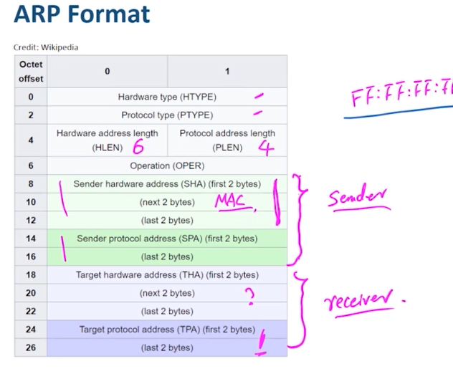
ARP Format

Slide 13
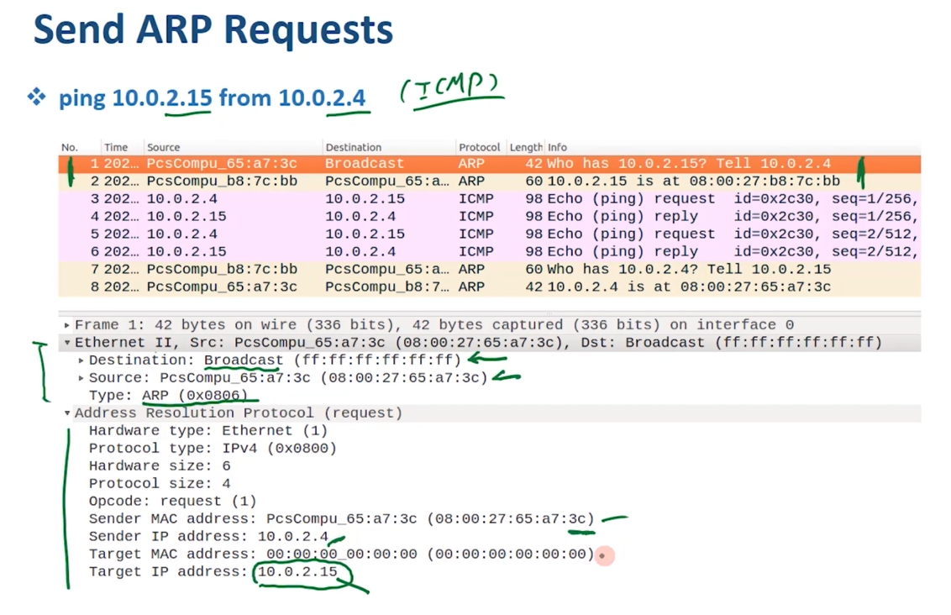
Send ARP Requests

Slide 14
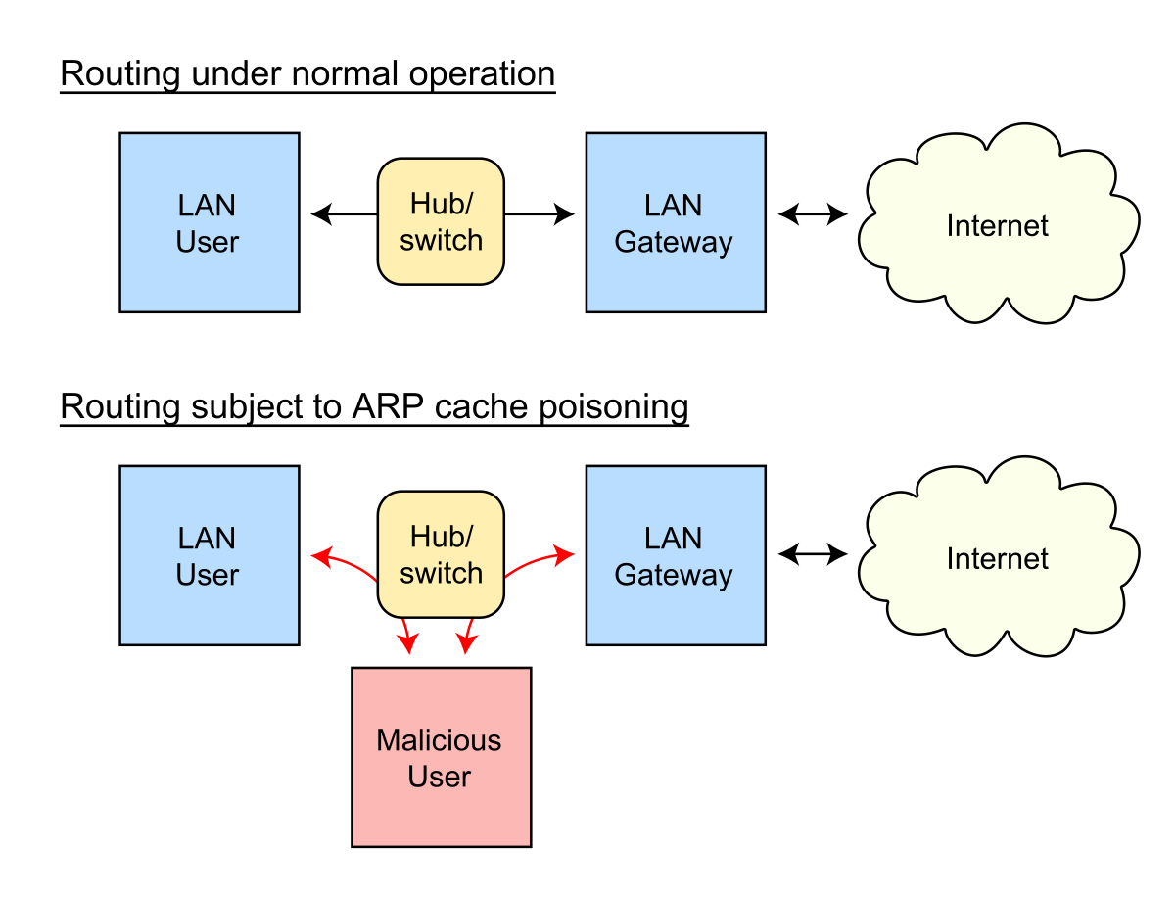
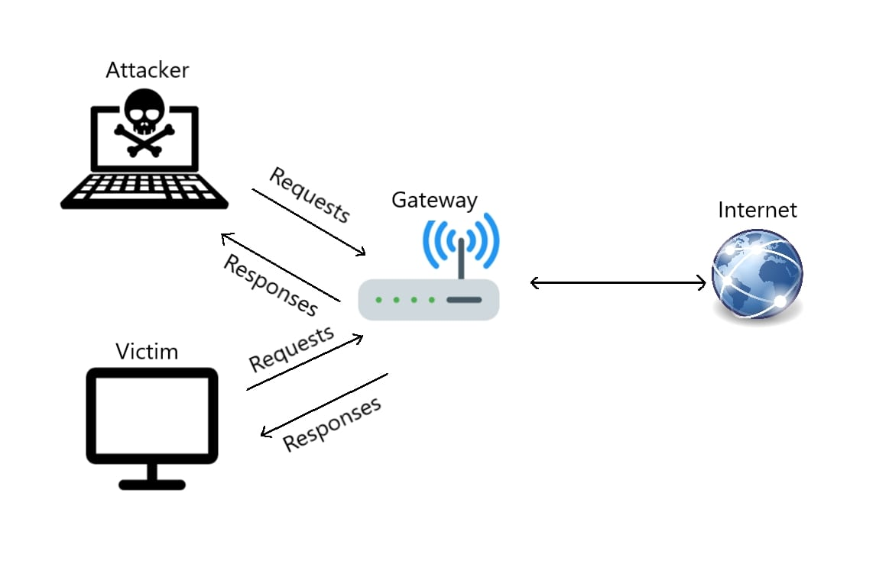
ARP Cache Poisoning

Slide 15
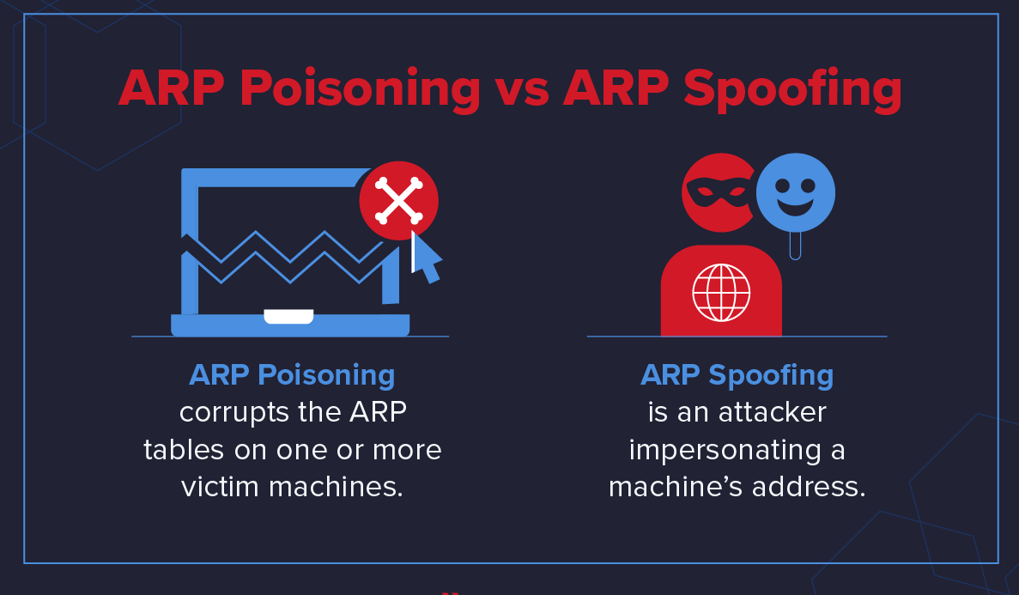
ARP Poisoning vs ARP Spoofing

Slide 16
Thank You

